Slide 1
COMPUTER NETWORKS

Slide 2
PART I
Introduction
“The kingdom of God is like a net…”
--Matthew 13:47

Slide 3
INTRODUCTION (CONT’D)
The Historical Perspective
  The 18th century: the great mechanical systems accompanying the Industrial Revolution.
  The 19th century: steam engine.
  The 20th century: information gathering, processing, and distribution.
  The 21th century: Internet, large distributed systems (e.g., Grid), heavy reliance on computers.

Slide 4
INTRODUCTION (CONT’D)
What is Computer Network?
  we will use the term ''computer network'' to mean a collection of autonomous computers interconnected by a single technology.
  Two computers are said to be interconnected if they are able to exchange information.
  copper wire; fiber optics, microwaves, infrared, and communication satellites, etc.

Slide 5
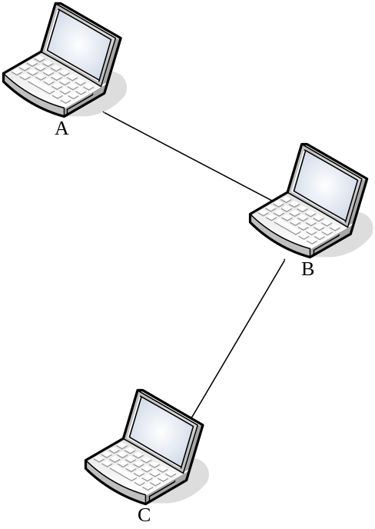
INTRODUCTION (CONT’D)
A very simple network (Problems)
  Digital-Analog ; Analog-Digital.
  What if error happens?
  Capture of physical lines – short message.
  Routing.
  Channel utilization (flow control).
  Who say first?
  Masking the details.

Slide 6
INTRODUCTION (CONT’D)
Network Hardware (transmission technologies)
  Broadcast
    Broadcast networks have a single communication channel that is shared by all the machines on the network. Short messages, called packets in certain contexts, sent by any machine are received by all the others. (Address Checking required)
  Point-to-point
    In point-to-point networks, there consist of many connections between individual pairs of machines.
  As a general rule (although there are many exceptions), smaller, geographically localized networks tend to use broadcasting, whereas larger networks usually are point-to-point.

Slide 7
INTRODUCTION (CONT’D)
Network Hardware (Scale Perspective)
  personal area networks (1m)
  LAN: local area networks (10m ~ 1km)
  MAN: metropolitan area networks (10km)
  WAN: wide area network (100km ~ 1000km)
  Internet

Slide 8
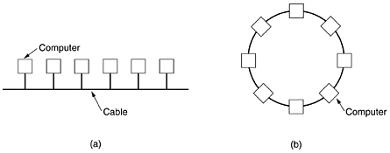
INTRODUCTION (CONT’D)
LAN: local area network
  Local area networks, generally called LANs, are privately-owned networks within a single building or campus of up to a few kilometers in size.
  LANs may use a transmission technology consisting of a cable to which all the machines are attached.
  Traditional LANs run at speeds of 10 Mbps to 1000 Mbps, have low delay (microseconds or nanoseconds), and make very few errors.
  Various topologies are
  possible for broadcast
  LANs.
(a) Bus (b) Ring

Slide 9
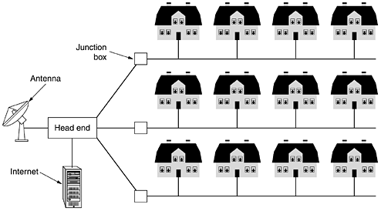
INTRODUCTION (CONT’D)
MAN: metropolitan area network

Slide 10
INTRODUCTION (CONT’D)
WAN and Internet
  Hosts, The hosts are owned by the customers (e.g., people's personal computers).
  Subnet, typically owned and operated by a telephone company or Internet service provider (ISP).
  The hosts are connected by subnets.
  the subnet consists of two distinct components: transmission lines and switching elements. Transmission lines move bits between machines. Switching elements (routers) are specialized computers that connect three or more transmission lines.

Slide 11
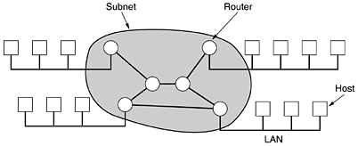
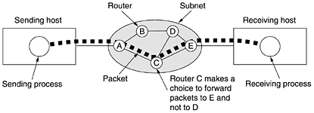
INTRODUCTION (CONT’D)
WAN and Internet
Simple WAN (Internet) illustrated
Packets routing

Slide 12
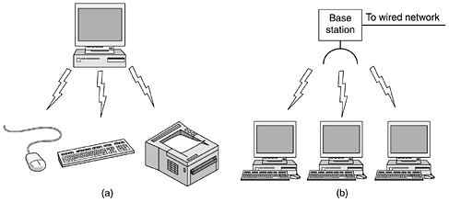
INTRODUCTION (CONT’D)
Wireless Networks
  Bluetooth: short range wireless network (<10m).
  Wireless LANs: for moderate range, becomes more and more common today (<100m).
  network used for cellular telephones: distances involved are much greater and the bit rates much lower (above 1km).

Slide 13
INTRODUCTION (CONT’D)
Network Software
  Protocol Hierarchies
  Design Issues for the Layers
  Connection-Oriented and Connectionless Services
  Service Primitives
  The Relationship of Services to Protocols

Slide 14
INTRODUCTION (CONT’D)
Protocol Hierarchies
  To reduce their design complexity, most networks are organized as a stack of layers or levels, each one built upon the one below it.
  The purpose of each layer is to offer certain services to the higher layers, shielding those layers from the details of how the offered services are actually implemented.
  A protocol is an agreement between the communicating parties on how communication is to proceed.

Slide 15
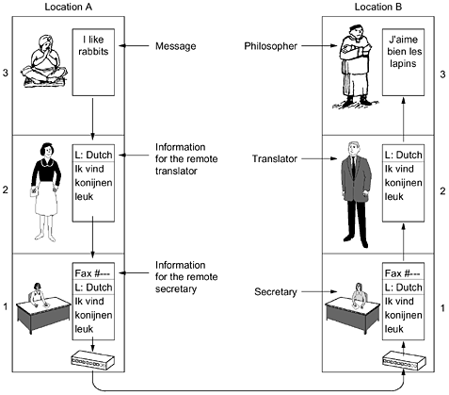
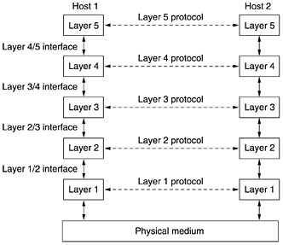
INTRODUCTION (CONT’D)
The philosophers analogy
The layered computer network

Slide 16
INTRODUCTION (CONT’D)
The key terms
  Layers; Protocol;
  Interface: Between each pair of adjacent layers is an interface.
  Network architecture: A set of layers and protocols is called a network architecture.
  Protocol stack: A list of protocols used by a certain system, one protocol per layer, is called a protocol stack.

Slide 17
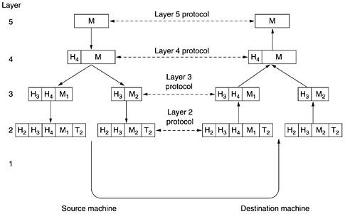
INTRODUCTION (CONT’D)
An example network protocol stack

Slide 18
INTRODUCTION (CONT’D)
Message is generated by the application of the source machine.
Message will be sent from the source to the destination.
Message “M” is transferred from layer 5 to layer 4, with a header containing control information, such as sequence numbers, which helps layer 4 maintain the message order.
Layer 3 break the message from layer 4 into two pieces to fit the transmission restrictions, while adding another header to tell layer 2 where the dest. is.
Layer 2 adds the messages from layer 3 with another header, telling the actual (physical) address of the dest, and a trailer, which is the checksum of the message for correction assertion.
At the receiving machine the message moves upward, from layer to layer, with headers being stripped off as it progresses. Message is sent to the dest. machine.

Slide 19
INTRODUCTION (CONT’D)
Design Issues for the Layers
  Every layer needs a mechanism for identifying senders and receivers. (who to talk with)
  The protocol must also determine how many logical channels the connection corresponds to and what their priorities are. (simplex or duplex? single or multiple channel?)
  Error control is an important issue because physical communication circuits are not perfect.
  Message ordering is important ‘cause Not all communication channels preserve the order of messages sent on them.
  An issue that occurs at every level is how to keep a fast sender from swamping a slow receiver with data.
  Inability of all processes to accept arbitrarily long messages. (fragmentation and reassembling the messages)

Slide 20
INTRODUCTION (CONT’D)
Connection-Oriented and Connectionless Services?
  Connection-Oriented Service: the service user first establishes a connection, uses the connection, and then releases the connection. (e.g., the telephone, tube)
  Connectionless Service: Each message carries the full destination address, and each one is routed through the system independent of all the others. (e.g., the postal system) Usually, connectionless service can not guarantee the order of messages.
  In order to enhance the reliability of transmission of connection-oriented service, acknowledge each received message is helpful. For example, the file transfer.
  However, some applications prefer fast speed than the reliability. For example, the digitized voice traffic, video conference.

Slide 21
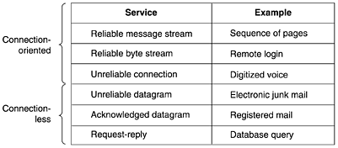
INTRODUCTION (CONT’D)
Six different types of service
both reliable and unreliable connection-oriented and connectionless communication coexist

Slide 22
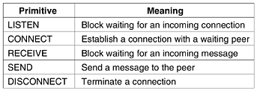
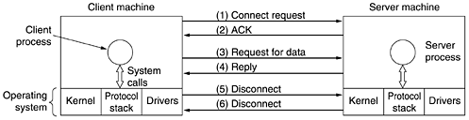
INTRODUCTION (CONT’D)
Service Primitives
Common Primitives
Packets sent in a simple client-server interaction on a connection-oriented network

Slide 23
INTRODUCTION (CONT’D)
Reference Models
  OSI reference model
    developed by the International Standards Organization (ISO)
    OSI means Open Systems Interconnection
    It is rarely used today, while it is actually quite general and still valid, and the features discussed at each layer are still very important.
    OSI model itself is not a network architecture because it does not specify the exact services and protocols to be used in each layer.
  TCP/IP reference model.
    developed by ARPANET
    Used to construct the Internet today
    However, the model itself is not of much use

Slide 24

INTRODUCTION (CONT’D)
OSI model

Slide 25
INTRODUCTION (CONT’D)
The Physical Layer
  The physical layer is concerned with transmitting raw bits over a communication channel.
  Typical questions here are how many volts should be used to represent a 1 and how many for a 0, how many nanoseconds a bit lasts, whether transmission may proceed simultaneously in both directions, how the initial connection is established and how it is torn down when both sides are finished, and how many pins the network connector has and what each pin is used for.
The Data Link Layer
  The main task of the data link layer is to transform a raw transmission facility into a line that appears free of undetected transmission errors to the network layer.
  having the sender break up the input data into data frames and transmit the frames sequentially

Slide 26
INTRODUCTION (CONT’D)
The Network Layer
  The network layer controls the operation of the subnet (routing).
  Congestion control, QOS (quality of service)
The Transport Layer
  The basic function of the transport layer is to accept data from above, split it up into smaller units if need be, pass these to the network layer, and ensure that the pieces all arrive correctly at the other end.
  The transport layer is a true end-to-end layer, all the way from the source to the destination.
  layers 1 through 3 are chained, and layers 4 through 7 are end-to-end,

Slide 27
INTRODUCTION (CONT’D)
The Session Layer
  The session layer allows users on different machines to establish sessions between them. Sessions offer various services, including dialog control, token management, and synchronization.
The Presentation Layer
  concerned with the syntax and semantics of the information transmitted, to make it possible for computers with different data representations to communicate.
The Application Layer
  The application layer contains a variety of protocols that are commonly needed by users.

Slide 28
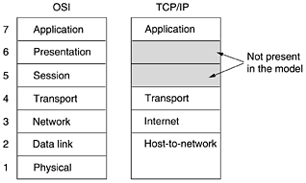
INTRODUCTION (CONT’D)
The TCP/IP Reference Model
The TCP/IP reference model

Slide 29
INTRODUCTION (CONT’D)
The Internet Layer
  Its job is to permit hosts to inject packets into any network and have them travel independently to the destination (potentially on a different network). They may even arrive in a different order than they were sent, in which case it is the job of higher layers to rearrange them, if in-order delivery is desired.
  The internet layer defines an official packet format and protocol called IP (Internet Protocol). The job of the internet layer is to deliver IP packets where they are supposed to go.
  The underlining Host-to-Network Layer is a great void. host connected to this layer can send IP packets.

Slide 30
INTRODUCTION (CONT’D)
The Transport Layer
  It is designed to allow peer entities on the source and destination hosts to carry on a conversation
  Two end-to-end transport protocols have been defined here. The first one, TCP (Transmission Control Protocol), is a reliable connection-oriented protocol that allows a byte stream originating on one machine to be delivered without error on any other machine in the internet.
  The second protocol in this layer, UDP (User Datagram Protocol), is an unreliable, connectionless protocol for applications that do not want TCP's sequencing or flow control and wish to provide their own.

Slide 31
INTRODUCTION (CONT’D)
The Application Layer
  The TCP/IP model does not have session or presentation layers, which are of little use to most applications.
  It contains all the higher-level protocols. The early ones included virtual terminal (TELNET), file transfer (FTP), and electronic mail (SMTP). Many other protocols have been added to these over the years: the Domain Name System (DNS) for mapping host names onto their network addresses, NNTP, the protocol for moving USENET news articles around, and HTTP, the protocol for fetching pages on the World Wide Web, and many others.

Slide 32
INTRODUCTION (CONT’D)
Comparison of the OSI and TCP/IP Reference Models
  Similarities
    Both are based on the concept of a stack of independent protocols.
    Both of them have transport layer to provide an end-to-end, network-independent transport service
  Differences
    In OSI, a layer's service definition tells what the layer does, and a layer's interface tells the processes above it how to access it, without explaining how the layers works inside.
    The TCP/IP model did not clearly distinguish between service, interface of the layers.
    As a consequence, the protocols in the OSI model are better hidden than in the TCP/IP model and can be replaced relatively easily as the technology changes.
    OSI model strives to describe the general model of network protocols, while TCP/IP model is specific as it is defined after the real implementations. So TCP/IP model is not useful to describe other protocols.

Slide 33
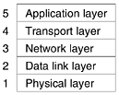
INTRODUCTION (CONT’D)
The hybrid reference model to be used in this book.

Slide 34
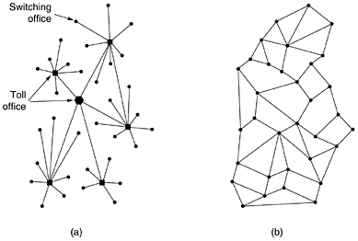
INTRODUCTION (CONT’D)
Example Networks —— The Internet 1
Structure of the telephone system.
(b) Baran's proposed distributed switching system.

Slide 35
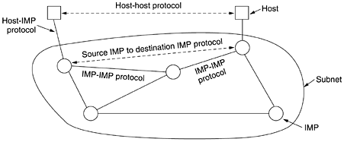
INTRODUCTION (CONT’D)
Example Networks —— The Internet 2
The original ARPANET design (IMP means Interface Message Processors)

Slide 36
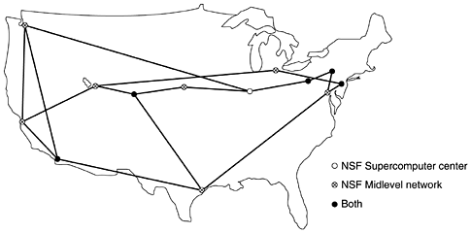
INTRODUCTION (CONT’D)
Example Networks —— The Internet 3
The NSFNET backbone in 1988

Slide 37
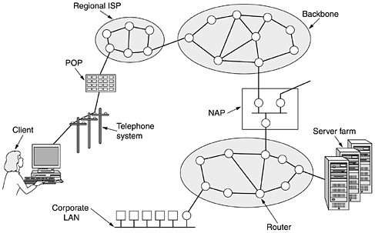
INTRODUCTION (CONT’D)
Example Networks —— The Internet 4
Architecture of the Internet today

Slide 38
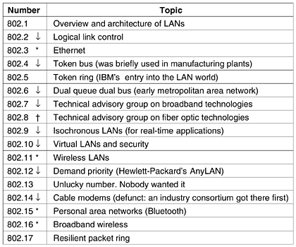
INTRODUCTION (CONT’D)
Network Standardization
The IEEE 802 series standards. The important ones are marked with *. The ones marked with ↓ are hibernating. The one marked with t gave up and disbanded itself.

Slide 39
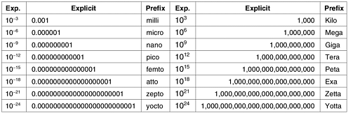
INTRODUCTION
Metric Units
Take care of “B” and “b”, “B” means byte, while “b” stands bit.
E.g., 1 KB/s = 8 Kb/s. B/s = Bps, b/s = bps.
1K = 2¹⁰ ≠ 10³ ≈ 1,000
1K = 2¹⁰; 1M = 2²⁰; 1G = 2³⁰ …

